Slide 1
Welcome!
Course: SE450 (Object-Oriented Software Development)
Instructor: Jeffrey Sharpe

Slide 2
Today’s class
Introduction to SE450
Basic Object-Oriented principles
Intro to UML
Development Process
Unit testing
Refactoring

Slide 3
Administration and Introduction

Slide 4
Attendance
This is the one and only time I will take attendance.
All you must do is log in to D2L and I will get confirmation that you are attending this course. You MUST do this by EOD Saturday, 6/18.

Slide 5
Intro to SE450
What is this course about?
Not just programming (e.g. working out algorithms) but taking advantage of features of OO languages to design programming solutions.

Slide 6
Intro to SE450
When you say “designing programming solutions”, you mean…..?
When you have a large, complex solution, you are likely to have multiple projects/packages/dlls and multiple classes, interfaces, etc. It is beneficial to know how to structure code in large solutions to keep it maintainable (lower risks of breaking things…).

Slide 7
Intro to SE450
In school, you generally write different assignments week-to-week. Once the code has been turned in, you never look at it again
In the real world, you will likely work on the same code as (potentially) dozens of others, many of whom may not be with the company any more. In addition, you work on the same codebase for a significant portion of your career at a company

Slide 8
Intro to SE450
Because you have to either work with others or at least work on the same project long-term, everyone benefits from writing the most maintainable code they can. The better the code and the design, the easier it is to make changes/additions to the code when requirements are changed/added and the less risky they are.
This course is about taking advantage of Object-Oriented concepts to write maintainable, extensible code.

Slide 9
About me

Slide 10
Syllabus

Slide 11
Intro to SE450
This is NOT an easy course! You MUST be comfortable with programming. You should be familiar with Java or another similar language.

Slide 12
Java Self Assessment
Do the following (in Java):
Develop a linked list class.
Code it from scratch.
Support the usual operations on a list such as insertion and deletion.
Support a toString method that returns the contents of the list as a string.
Develop a class hierarchy of shapes.
Shapes include: Shape Closed Shape Circle, Rectangle, ... Open Shape Line, Curve, ... Text
Each class supports a method toString that returns the attributes of the shape as a string.
Instantiate a list of shapes. Insert several different shapes into the list, and print out the contents of
the list of shapes.
If you have:
no difficulty --- fine
some difficulty --- make sure you have lots of time to devote to this class
major difficulty --- you will find this class extremely difficult

Slide 13
Talking about code issues
If you have any questions about the programming assignments, post in D2L.
ALWAYS include the error text and the relevant code in your D2L post when asking for help!

Slide 14
Project Check-ins
Project check-ins are 20% of your grade. Project check-ins will be due at 11:30pm CT on Thursdays. Functionality and the number of patterns indicated must be complete.
The Final Code submission is due August 20th at 11:30pm
No late work is accepted.

Slide 15
Final Project
The project is worth 40% of your total grade. You will build a Paint-like application called JPaint. You will be required to implement design patterns to implement certain features. While you will have the final say in decisions relating to the design, I will make certain suggestions.
Every two weeks begins a “sprint”. A set of features will need to be completed during the sprint. DO NOT FALL BEHIND.

Slide 16
Quizzes
Quizzes are worth 10% of your grade. Every week, you will take a quiz based on material from the week’s lecture in D2L. Due by 5:30pm Wednesdays. We will go through the quiz answers in class.

Slide 17
Contact information
Email:
jsharpe1@depaul.edu
Typically respond within 24 hours

Slide 18
Office hours
Wednesdays before class for 30 minutes on Zoom. Thursdays 5-6 on Zoom.
You can make an appointment through BlueStar; access BlueStar through CampusConnect.

Slide 19
OO Programming Basics
Most of this should be review

Slide 20
Members
Three types of members in java:
Methods/Functions
Fields
Constructors

Slide 21
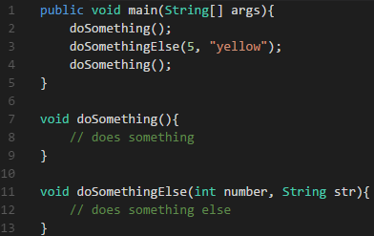
What is a function?
Function: set of expressions that can be referenced by a human-readable name that defines its behavior. Functions allow for easier maintainability of behavior. A function provides a layer of abstraction.

Slide 22
What’s the difference between a function and a method?
A function is like a mathematical equation: You put in some input and get some output. The output is always the same for the same input. In other words, there are no side effects.
A method is some behavior of an object. There may be side effects. There may be external forces that change the outcome of a method for the same input.

Slide 23
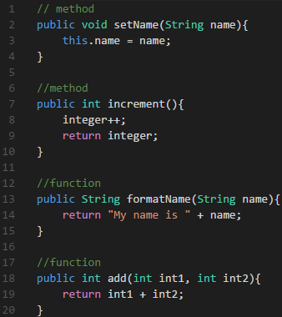
Methods and functions

Slide 24
Methods and functions
The terms are used interchangeably out in the real world, and I will be using them interchangeably in this class.

Slide 25
What is a field?
A Field, sometimes called class variable, stores some state for a class. Can be any type (int, boolean, etc.)
Each object has its own state. The state is what separates two objects from each other in terms of behavior. If you had two objects with the same state, they should behave identically (with one small but important exception which I will discuss in a bit).

Slide 26
What is a constructor?
Code that runs when an object is instantiated. This should be used to initialize any default values. Think of it as putting an object into a good state once it’s been initialized.

Slide 27
What is a class?
Group of related members. Essentially, it is a template for objects.

Slide 28
What is an object?
An object is an instance of a class.
A class describes an object.

Slide 29
What’s the difference?
Class is a template; object is something concrete made from that template.
Example: Twitter profile. Each Twitter profile has a name, photo, etc. My Twitter page has my name and my cover photo

Slide 30
Objects and classes/compile-time vs run-time
At Compile-time (the point in time where you are working on your code), you are only working with classes
At Run-time (when your code is being run), you are only working with objects.

Slide 31
Objects and classes/compile-time vs run-time
Let’s say a method takes in a TwitterProfile as an argument. At compile-time, I know this TwitterProfile has a name. At run-time, I know the value of name on this TwitterProfile is “Jeffrey Sharpe”

Slide 32
Mutability
Objects may be mutable or immutable.
If an object is immutable, it means it can’t be changed once it’s been created. Strings are an example of this. Immutable objects’ states are set in the constructor and then never modified.
If an object is mutable, it can be changed once it’s been created. If there are any set methods on the object or if any fields are publicly accessible, it is mutable.

Slide 33
Static members
Classes may have members which are marked with the static keyword. In Java, a static constructor doesn’t actually use the static keyword, it uses different syntax. Static members are members that are shared by all instances of the same class and static methods don’t require an instance to be called.
In a sense, this allows the Type to have some functionality (allow the type to have some state, allow the type to have some functionality, etc.) without needing to have an instance.

Slide 34
Static fields
A static field is a field that is shared by all objects of that type in an application. They are also useful for storing const values (for example, Integer.MAX_VALUE).

Slide 35
Static methods
A static method is a method that can only reference objects passed in as parameters and other static members. It can’t use instance variables of the same class. Static methods can be called in non-static contexts as well as static contexts.

Slide 36
Static constructors
A static constructor is a constructor that runs when the class is used for the first time in an application. You might use one to set some public static fields with default values, for instance.

Slide 37
Static vs non-static classes
Some classes may be static. In C#, you can explicitly mark a class static. In Java, static classes are defined only by its members. A class is static if it only contains static members.
You cannot (or at least should not) instantiate a static class. You can force the issue by making the constructor private.

Slide 38
Primitive types vs reference types
In Java, there are Primitive and Reference types.
Primitives (also called value types) live on the stack. When you instantiate a new reference type, a value is put on the stack as well, but the value is a memory address that points to an object in the heap. (example)
Some common primitives are ints, chars, and booleans, among others. Reference types are any class, including Object, String, Array, or any class you create.

Slide 39
What does the following print out?
public class Main {
private Main() {}
static public void main (String[] args) {
int x = 42;
int y = 27;
Main.swap(x,y);
System.out.println(x);
System.out.println(y);
}
private static void swap (int a, int b) {
int t = a;
a = b;
b = t;
}
}

Slide 40
Method parameters
The reason this happens is because in Java, method parameters are “call-by-value”. This means the value of the variable is copied into the method parameters on the stack. The variables in the calling scope are untouched.
(example)
In C#, you can force call-by-reference by using the ref keyword.

Slide 41
What does the following print out?
public class Main {
public static void main(String[] args){
String x = "hello";
String y = "world";
swap(x, y);
System.out.println(x);
System.out.println(y);
}
public static void swap(String a, String b){
String t = a;
a = b;
b = t;
}
}

Slide 42
Method parameters
While you can’t modify the pointer of the object that’s passed in, you can modify attributes on the object it’s pointing to if it’s mutable.

Slide 43
What does the following print out?
public class Main {
public static void main(String[] args) {
StringObject x = new StringObject("hello");
StringObject y = new StringObject("world");
swap(x, y);
System.out.println(x);
System.out.println(y);
}
public static void swap(StringObject a, StringObject b) {
String t = a.str; a.str = b.str; b.str = t;
}
}
class StringObject{
public String str;
public StringObject(String str){ this.str = str; }
public String toString(){ return str; }
}

Slide 44
Equality comparisons
In Java, == and .equals() do not have equivalent functionality in some situations.
When you are comparing two primitives (ints, booleans, etc.), you have to use ==.
However, if you are comparing two reference types, you might be introducing a bug into your program if you use the wrong comparison operator.

Slide 45
What does the following print out?
public class Main {
public static void main(String[] args) {
int a = 4;
int b = 4;
boolean comparisonResult = a == b;
System.out.println(comparisonResult);
// The following line does not compile.
// comparisonResult = a.equals(b);
// System.out.println(comparisonResult);
StringObject x = new StringObject("hello");
StringObject y = new StringObject("hello");
comparisonResult = x == y;
System.out.println(comparisonResult);
comparisonResult = x.equals(y);
System.out.println(comparisonResult);
}
}
class StringObject {
public String str;
public StringObject(String str) {
this.str = str;
}
public String toString() {
return str;
}
}

Slide 46
==
== compares the value on the stack. For primitives, this is the actual value of the variable you would expect. For reference types, this is the address of the pointer on the stack. So you are testing to see whether two stack variables are pointing to the same object in the heap. (example)

Slide 47
.equals()
If you don’t override .equals() in a new class, it will inherit from the parent class. In Java, the parent class is implicitly Object if no base class is otherwise specified.
The default implementation of .equals() in Object is the same as ==, which is why using .equals() in the previous example didn’t make a difference.

Slide 48
Add a .equals method to StringObject
public class Main {
public static void main(String[] args){
int a = 4;
int b = 4;
boolean comparisonResult = a == b;
System.out.println(comparisonResult);
// The following line does not compile.
// comparisonResult = a.equals(b);
// System.out.println(comparisonResult);
StringObject x = new StringObject("hello");
StringObject y = new StringObject("hello");
comparisonResult = x == y;
System.out.println(comparisonResult);
comparisonResult = x.equals(y);
System.out.println(comparisonResult);
}
}
class StringObject {
public String str;
public StringObject(String str){
this.str = str;
}
public String toString(){
return str;
}
}

Slide 49
UML

Slide 50
UML
UML – Unified Modeling Language – is a standardized (ISO) tool to describe the design of a solution
Three primary types of UML Diagrams we will use in this class: Object Diagrams, Class Diagrams, and Sequence Diagrams
We will also – somewhat briefly – touch on Package Diagrams in a later class

Slide 51
UML
While you are unlikely to ever be required to use 100% proper UML outside of school – most of the time you will probably use a pseudo-UML – it is a common tool to help us all discuss the designs of solutions and design patterns in this class. In addition, it will still help you discuss designs with others even if they use pseudo-uml.

Slide 52
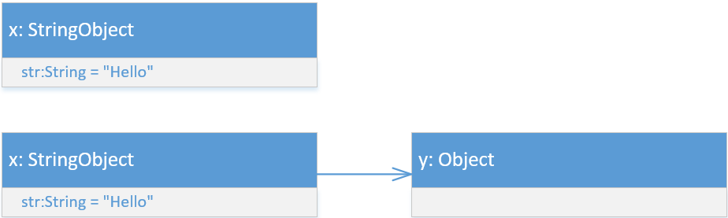
Object diagram
Use an Object Diagram to show the state of objects in a running program at a certain point in time.

Slide 53
Draw an object diagram
Draw an object diagram for the swap program at line 6.

Slide 54
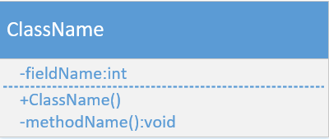
Class diagram
Show classes, their “metadata” and members, and how they relate to other classes.
Fields on top, methods below the divider.
For each member, there will be a visibility and type. The one exception is the Constructor will not have a type.
You do NOT need to show every member for a class in every class diagram. You only need to show the relevant members.

Slide 55
Draw a class diagram
Draw a class diagram for StringObject

Slide 56
Visibility in class diagrams
In Java, there are four types of visibility. I will go over what each visibility means in a later class, but this is how to represent each visibility in UML. For now, we will only use public and private.
+ is public
# is protected
~ is package private
- is private

Slide 57
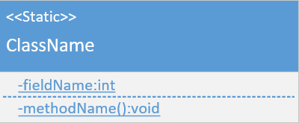
Class diagram for static class
Static classes have a stereotype. Static members are underlined.
If you had a non-static class with some static members, you would just underline the static members and would not use the stereotype.

Slide 58
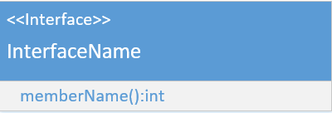
Class diagram for interface
Interfaces have a stereotype as well.
There are two differences between an interface and a class in class diagrams. Interfaces don’t have fields or constructors and you don’t need to put visibility markers on the methods. Why?

Slide 59
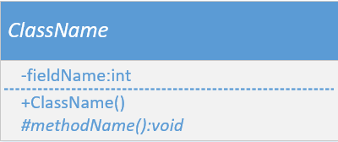
Class diagram for abstract class
We will discuss abstract classes in more detail later in the course. The class diagram is the same as a normal class diagram except that abstract members are italicized, as is the class name.

Slide 60
Class diagrams: referencing other objects
Five types of concrete relationships in class diagrams.
Aggregation
Composition
Dependency
Inheritance (Generalization/Specialization)
Interface Implementation

Slide 61
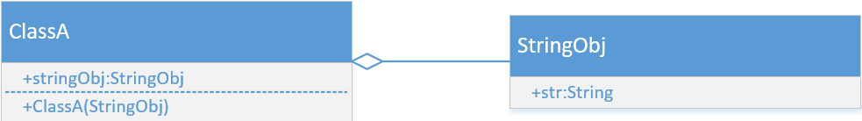
Aggregation
An aggregation relationship is when Class A has a field of type Class B. Further, the relationship to Class B is not guaranteed to be an exclusive reference. Think about a List. You add objects to the list, but the scope that creates the list still has references to those objects and can change them (code example). Aggregation relationships are represented with a hollow diamond.

Slide 62
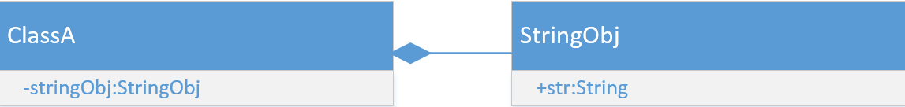
Composition
A composition relationship, similar to aggregation, is when Class A has a field of type Class B. Further, the relationship to Class B is guaranteed to be an exclusive reference. This means that the instance of Class B is created inside of Class A, and Class A doesn’t share that reference. Consequently, when Class A dies, the instance of Class B also dies.
Composition is represented by a filled diamond.
(example)

Slide 63
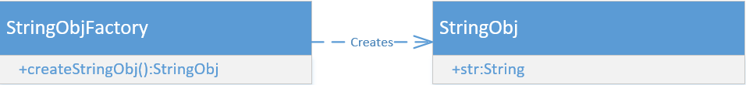
Dependency
A dependency relationship is when Class A utilizes Class B in some way, but doesn’t retain a reference to it. The following are examples of Dependencies:
Class B is returned by a method
Class B is a parameter for a method
Class B is held as a local variable but not a field
Dependencies are represented with a dashed line

Slide 64
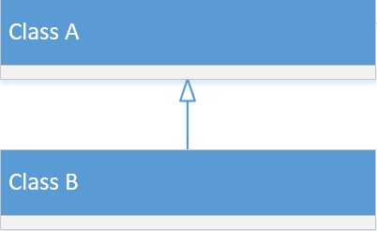
Inheritance (Generalization/Specialization)
When Class B extends Class A, this is called Inheritance. Inheritance is represented by a hollow, closed arrowhead with a solid line. You will also see this called Generalization or Specialization.

Slide 65
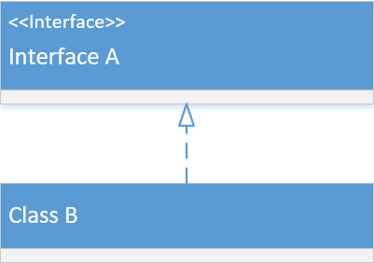
Interface Implementation
When Class B implements Interface A, this is called Interface Implementation. Interface Implementation is represented by a hollow, closed arrowhead with a dashed line.

Slide 66
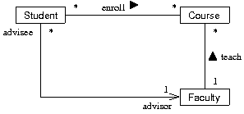
Association
The previous five relationships were concrete relationships. Association is an abstract relationship. What I mean by that is that an association doesn’t provide many details into what the relationship between two classes looks like. Association should be used for high-level planning. In this class, you will use the previous five concrete relationships exclusively.

Slide 67
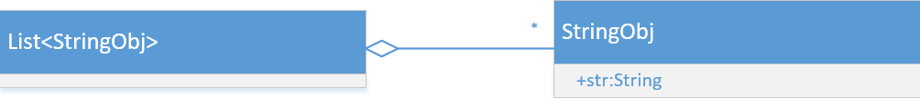
Multiplicity
Sometimes you want to express that in a relationship, there are multiple of something. You can do this using multiplicity.
Any number (0-infinity) is represented as *
Constrained (e.g. more than m but less than n) is represented as m..n
Exact (exactly n elements) is represented as n
The multiplicity goes on the far side of the relationship in the class diagram.

Slide 68
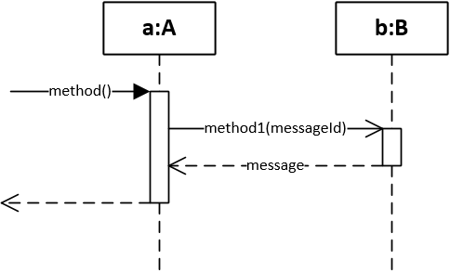
Uml sequence diagrams
Depicts a sequence of messages being passed around between objects for some method as well as depicts the length of activity for an object.
The sequence runs from top to bottom. The object being operated on is represented at the top. Vertical dashed lines are the object’s lifeline, and end when the object dies. Activity boxes represent the time the object has a method on the call stack.

Slide 69
Uml sequence diagrams
Kick off the sequence diagram by showing an arrow coming in and the name of the method call. Every method call will come with an arrow,
the name of that method, and any parameters for that method. Arrows for synchronous methods have closed, filled arrowheads, while asynchronous methods use open arrowheads. Use an arrow with a dashed line and an open arrowhead to show methods returning along with a label to describe what’s being returned.

Slide 70
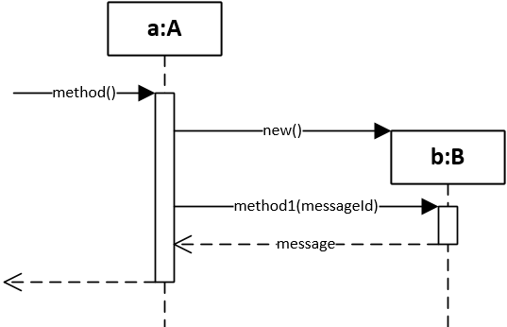
New object creation
When you create a new object, you will show an arrow with “new” and it will point to the box part of the new object, as below.

Slide 71
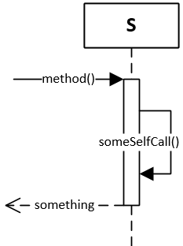
Static classes and self-messages
Static classes won’t have a variable name in the box at the top.
Self-calls (e.g. a method from one class calling another method on that same class) is represented as an arrow pointing back at the original object.

Slide 72
Conditionals
There are two types of conditionals in UML Sequence Diagrams.
Optional (a single if statement)
Alternative (multiple if/else conditions or switch statement)

Slide 73
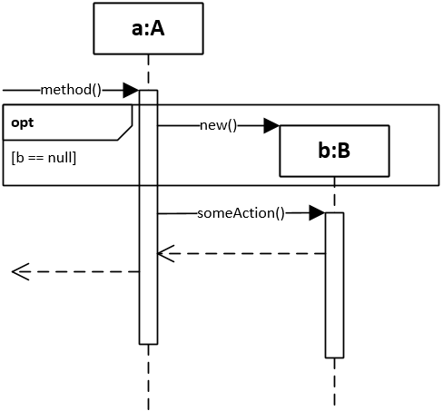
Optional
Optionals would be the equivalent of some code surrounded by an if statement (NO else statements).
You draw a box around the optional messages, put “opt” in the top left corner, and put the condition of the optional (what has to be true for it to run) underneath.

Slide 74
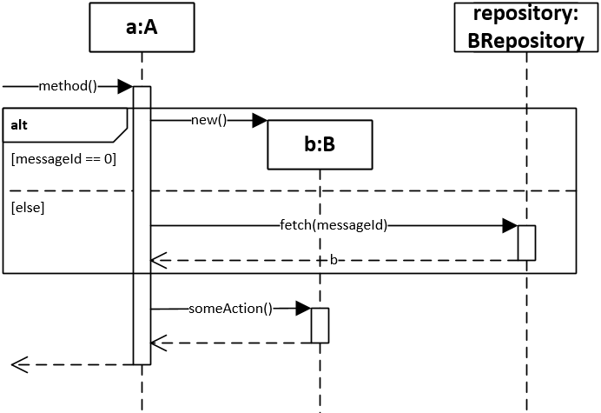
Alternative
Alternatives depict if/else statements or switch statements.
They are drawn the same way as Optionals, except you put “alt” in the top left corner, and there are multiple conditions separated by a line.

Slide 75
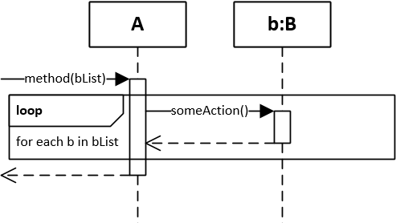
Loops
Loops are represented similarly to Optionals and Alternatives, except “loop” is placed in the top left corner and instead of a conditional, you put what the loop is iterating over.

Slide 76
Uml sequence diagram
Draw a UML Sequence Diagram for this code:
public class Main {
public static void main(String[] args) {
A a = new A();
a.run();
}
}
public class A {
public void run(){
B b = new B();
setupB(b);
String result = b.getValue(true);
System.out.println(result); // PrintStream
}
private void setupB(B b){
b.value = "A";
}
}
class B {
public String value;
public String getValue(boolean printLowerCase){
return value;
}
}

Slide 77
Development Process

Slide 78
Development process
Design one piece of functionality, accepting that your design will change. Designing ahead of time – even knowing that the design will change – will help prevent you from going down the wrong path right off the bat.
*Write code for one piece of functionality. Get it working.
*(Unit) Test. Make sure you don’t have any bugs in your code and it fulfills all the requirements.
Refactor. Refactoring is changing the code without changing the functionality. Clean up your code.
Iterate. Repeat steps 1-4 until your solution is complete.

Slide 79
Testing
Different types of testing:
Acceptance testing (Manual testing)
Unit testing

Slide 80
Acceptance testing
Make sure that the functionality matches what’s written in the user story or requirements document by running code.
For instance, if the user story was for adding a button on a web page that spawned some action, you would test by clicking the button and making sure that whatever was supposed to happen happened.
While this is usually manually done, there are tools for automated UI testing.

Slide 81
Unit testing
Unit testing is code that you write to test pieces of functionality.
Each test will run against those pieces of functionality and make assertions about the outcome. If the outcomes are not what is expected, then the test will fail.
Unit testing should be automated, where all tests run whenever changes are made.

Slide 82
Test methods
Outcomes of test methods shouldn’t affect other test methods. Each test method should start with a clean slate. In other words, each test method should be treated like a separate program.
Test names are typically along the lines of TestSomeActionWithSomeConditionHasSomeResult(). For example, a test name might be TestLogInWithInvalidAccountThrowsException.
Tests are laid out in three sections: Arrange, Act, Assert.

Slide 83
Test inputs
Test methods should check against a large variety of inputs
For instance, if a method you’re testing takes in an int as a parameter, test against negative values, 0, and positive values, as well as any edge cases
If a method takes in an object as a parameter, test with null.

Slide 84
What to do with broken tests
Fix broken tests by:
Fixing the bug
Changing the unit test (to reflect a change in requirements)
Delete the test (if it’s no longer necessary due to a change in requirements)

Slide 85
Regression Testing
Regression testing is testing all previously working functionality (even functionality unrelated to what changes you’ve made) to make sure your changes didn’t break anything.
If you have (good) unit tests covering a significant portion of your code, you have a built-in regression testing suite.

Slide 86
JUnit
We will be using JUnit 5 for testing in this class.
To use JUnit, first create a test class. The standard convention is for the test class to append “TEST” to the class name you are testing. The class must be public.
Next, import the relevant packages for testing. These are:
import static org.junit.jupiter.api.Assertions.*;
import org.junit.jupiter.api.Test;
Finally, add test methods. You will need to add an annotation to each test (@Test). Test methods will have a signature like public void test(). Test methods must be non-static

Slide 87
JUnit tests
Each test has one of three possible outcomes:
pass: test ended normally and no assertion failed
fail: test ended normally and at least one assertion failed
error: uncaught exception thrown before test ended

Slide 88
Common code between tests
You can use the @BeforeEach annotation to specify a method to run to initialize each test.

Slide 89
JUnit assertions
The basic assertion method is assertTrue which comes in two forms: One with a Boolean parameter and one with a String and a Boolean parameter. The Boolean value determines whether the test was successful. The String parameter is a message that is printed if the assertion fails.
If there are multiple assertions in a single test, then the enclosing test fails if any assertion is false.

Slide 90
More assertions
There are many other assertions that are available in JUnit:
fail()
assertFalse(boolean)
assertEquals(object, object)
assertSame(object, object)
assertNull(object)
assertNotNull(object)

Slide 91
Write a test for swap
public class Main {
public static void main(String[] args){
StringObject x = new StringObject("hello");
StringObject y = new StringObject("world");
swap(x, y);
System.out.println(x);
System.out.println(y);
}
public static void swap(StringObject a, StringObject b){
String t = a.str; a.str = b.str; b.str = t;
}
}
class StringObject{
public String str;
public StringObject(String str){ this.str = str; }
public String toString(){ return str; }
}

Slide 92
Refactoring
Refactoring is changing the structure of the code without changing its functionality
(function example)

Slide 93
Why refactor?
Erase potential areas for bugs
Improve design (increase potential for extensibility and maintainability)
Remove dependencies (decrease complexity)

Slide 94
When to refactor
A “code smell” is what we call an indicator of bad code. A code smell could be a poorly named variable or seeing the same code copied and pasted all over a project.
Code smells accumulate, causing technical debt. Technical debt is a need to refactor to eliminate code smells. You can use a static analysis tool like SonarQube to calculate the total technical debt in your project.
Refactor to alleviate technical debt.

Slide 95
How to refactor
1. Write unit tests to extensively cover the code that will be refactored
2. Plan your changes
3. Implement the changes
4. Run unit tests to make sure the code works the same as it did before
*If you use source control (and you should), make sure you have committed/checked in any other changes before starting the refactor.

Slide 96
Refactor demo
Refactor Swap so that it is no longer a static method but rather an instance method on StringObject.

